Slide 1

E-Commerce website in Django

Slide 2


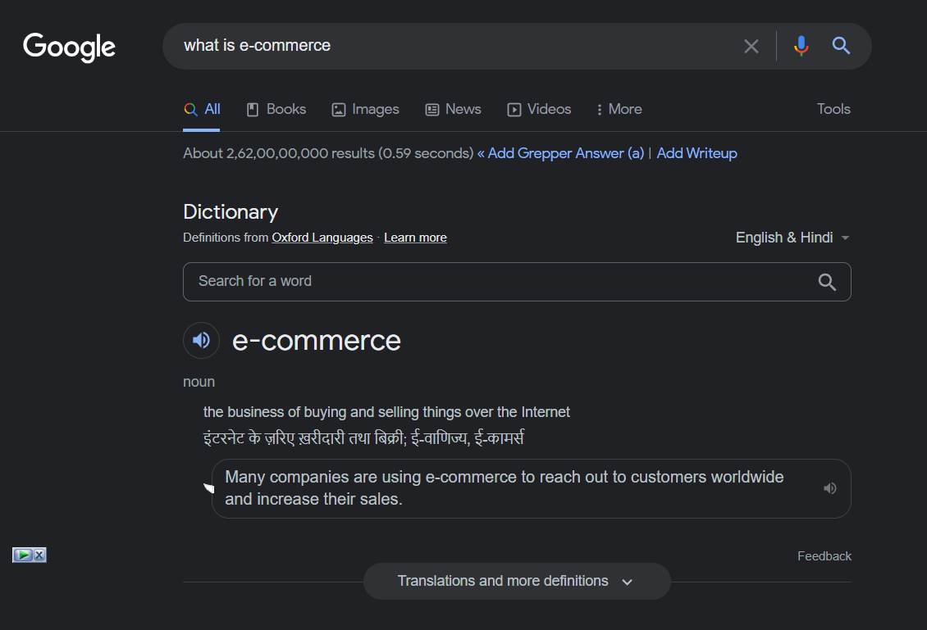
Introduction

Slide 3
Hello!
I am Mahesh Sharma
I am here because presentation of my project that name is Shopify
You can find me at @TechstarMahesh

Slide 4
Contents
Introduction
Objective of Project
Technology i used
SQL Table relation
Project Overview.
Future of project
Flow of Project
Conclusion
1

Slide 5

Objective of Project
Sell our product.
Automate our business.
Add new product or delete.
Admin/User Panel.
Order and cancel.

Slide 6
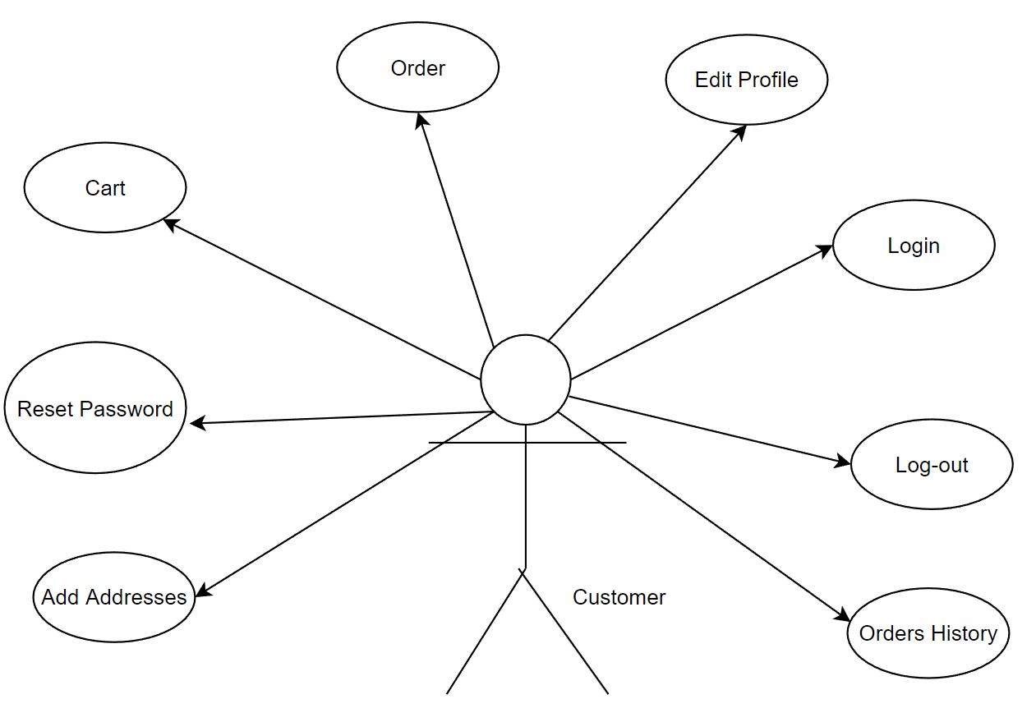
Customer use-case

Slide 7
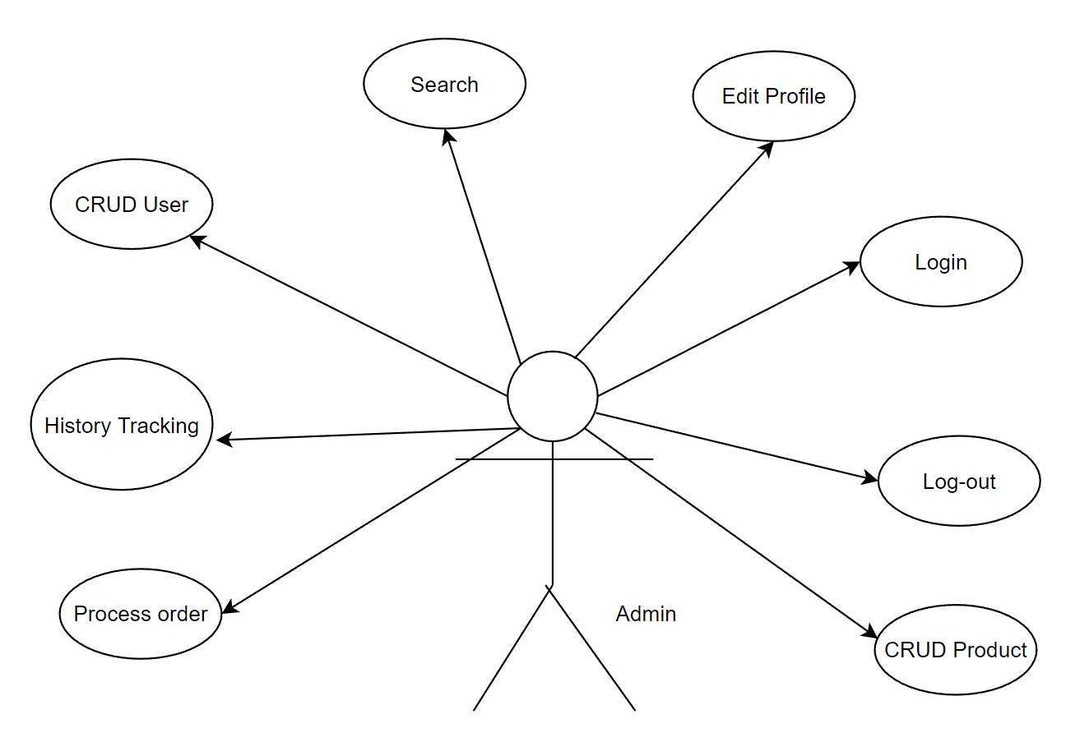
Admin use-case

Slide 8
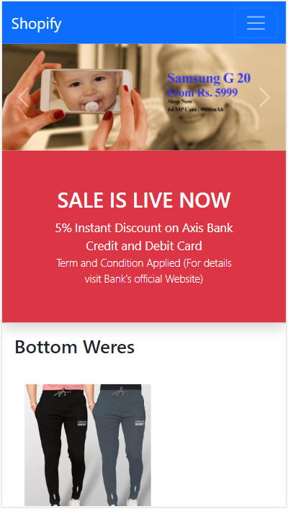
Mobile project
In Mobile it will be look like this and it is fully responsive

Slide 9
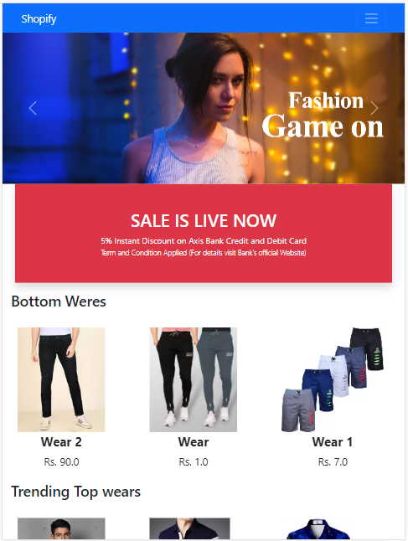
Tablet project
In Tab it will be look like this and it is fully responsive

Slide 10
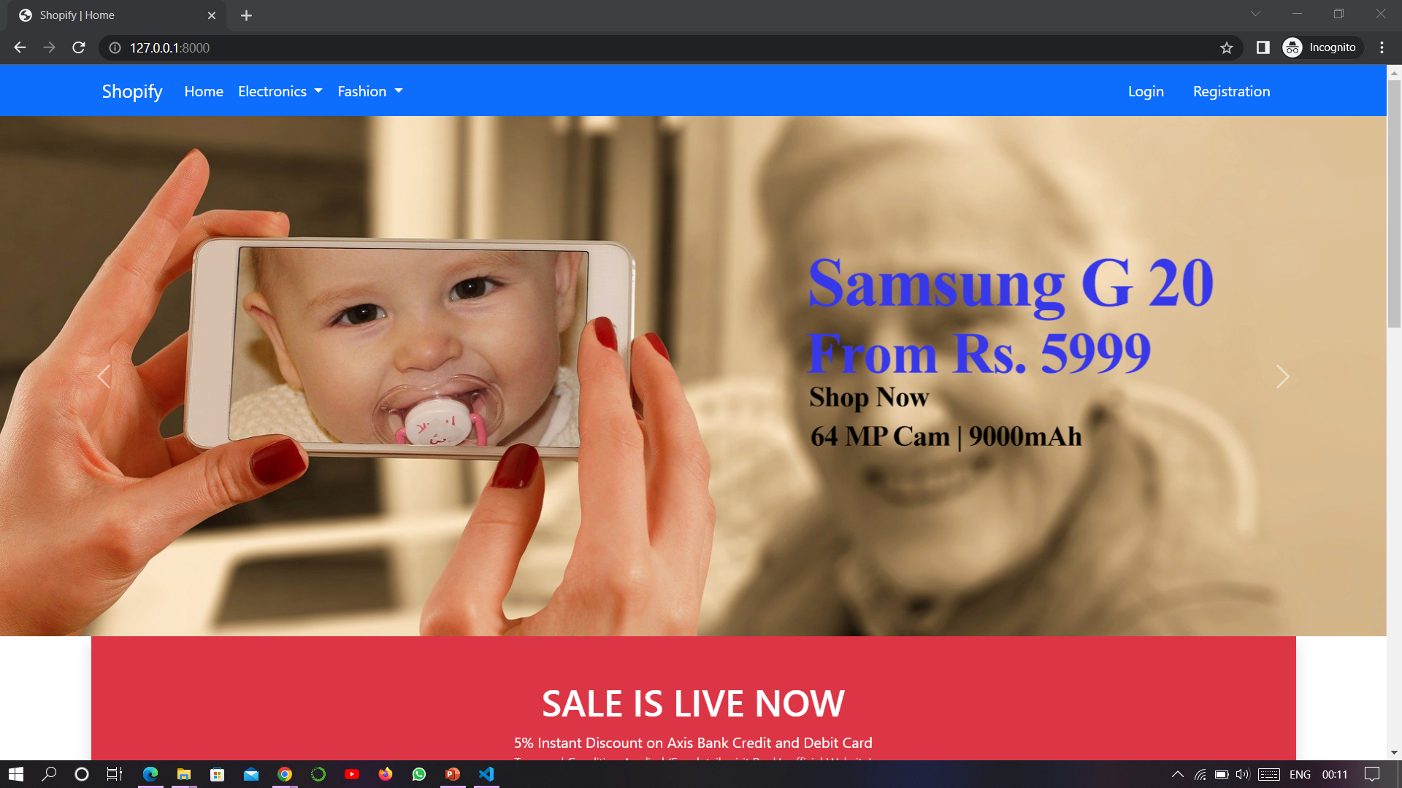
Desktop project
In desktop it will be look like this and it is fully responsive

Slide 11

Used Technology
Python
Django
HTML5
CSS 3
Bootstrap 5
SQLite.
JavaScript
Font Awesome
Jquery
Ajax
Github
SQLite.
Font Awesome

Slide 12
Module i use to make project
Django
Admin
User
Pillow
SQL
Migrations

Slide 13
SQL Table relation
Customer
User | ForeignKey
Name | CharField
Locality | CharField
City | CharField
Zip Code | CharField
State | CharField
User
Username | Username type
Password | Password type
First_name
Product
Title | CharField
Selling_price | FloatField
Discounted_price | FloatField
Description | TextField
Brand | CharField
Category | CharField
Product_image | ImageField
Orderplaced
User | ForeignKey
Customer | ForeignKey
Product | ForeignKey
Quantity | PositiveIntegerField
Ordered_date | DateTimeField
Status | Charfield
Cart
User ForeignKey
Product | ForeignKey
Quantity | PositiveIntegerField
All are many to one
relationship

Slide 14
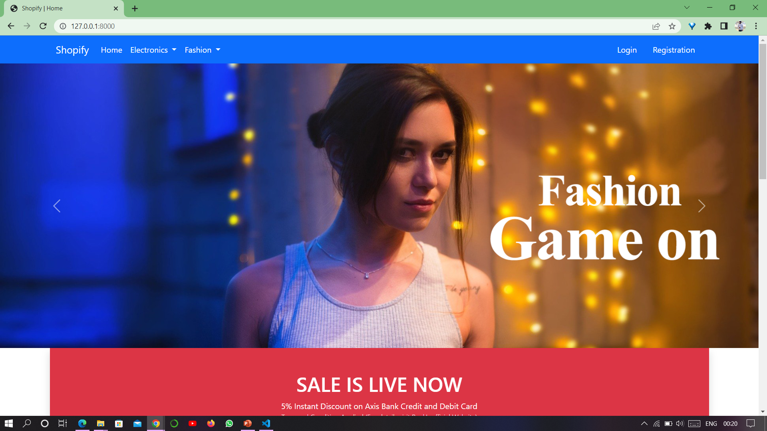
Lets shopping by Shopify

Slide 15
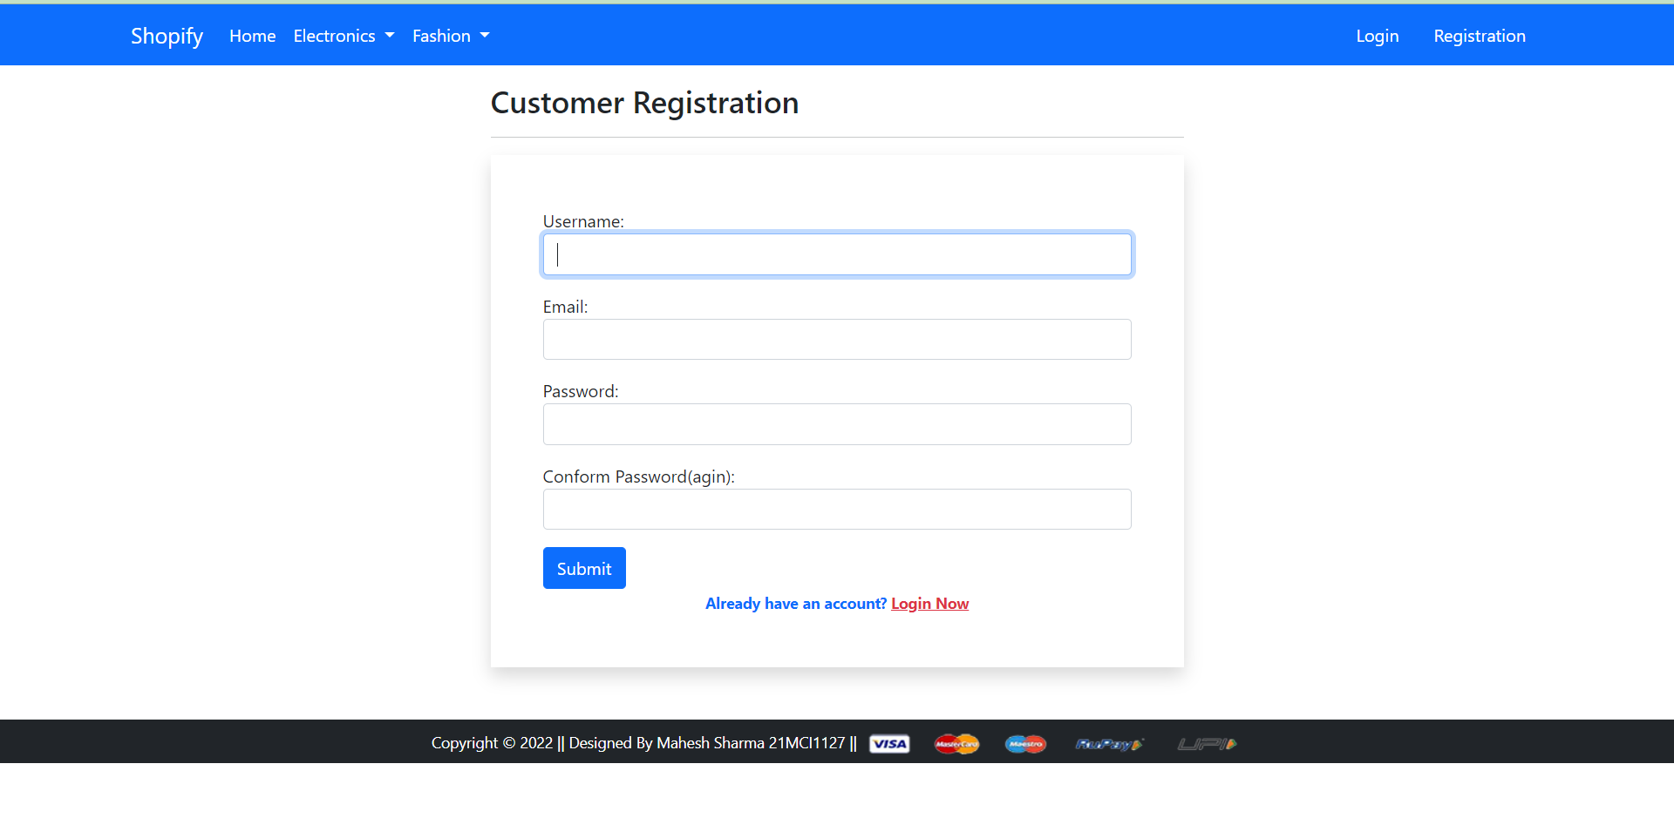
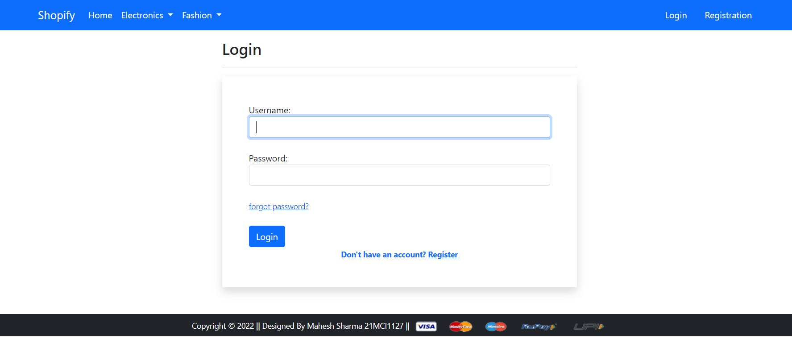
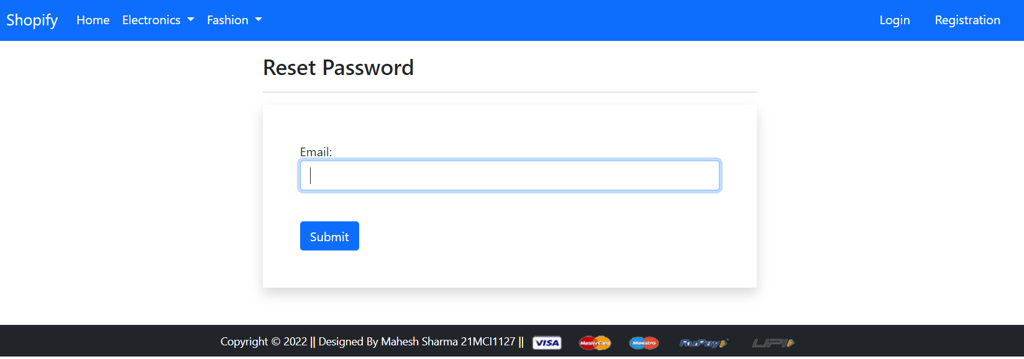
Do Registration
Login By giving username and password
If you forgot you password you can reset

Slide 16
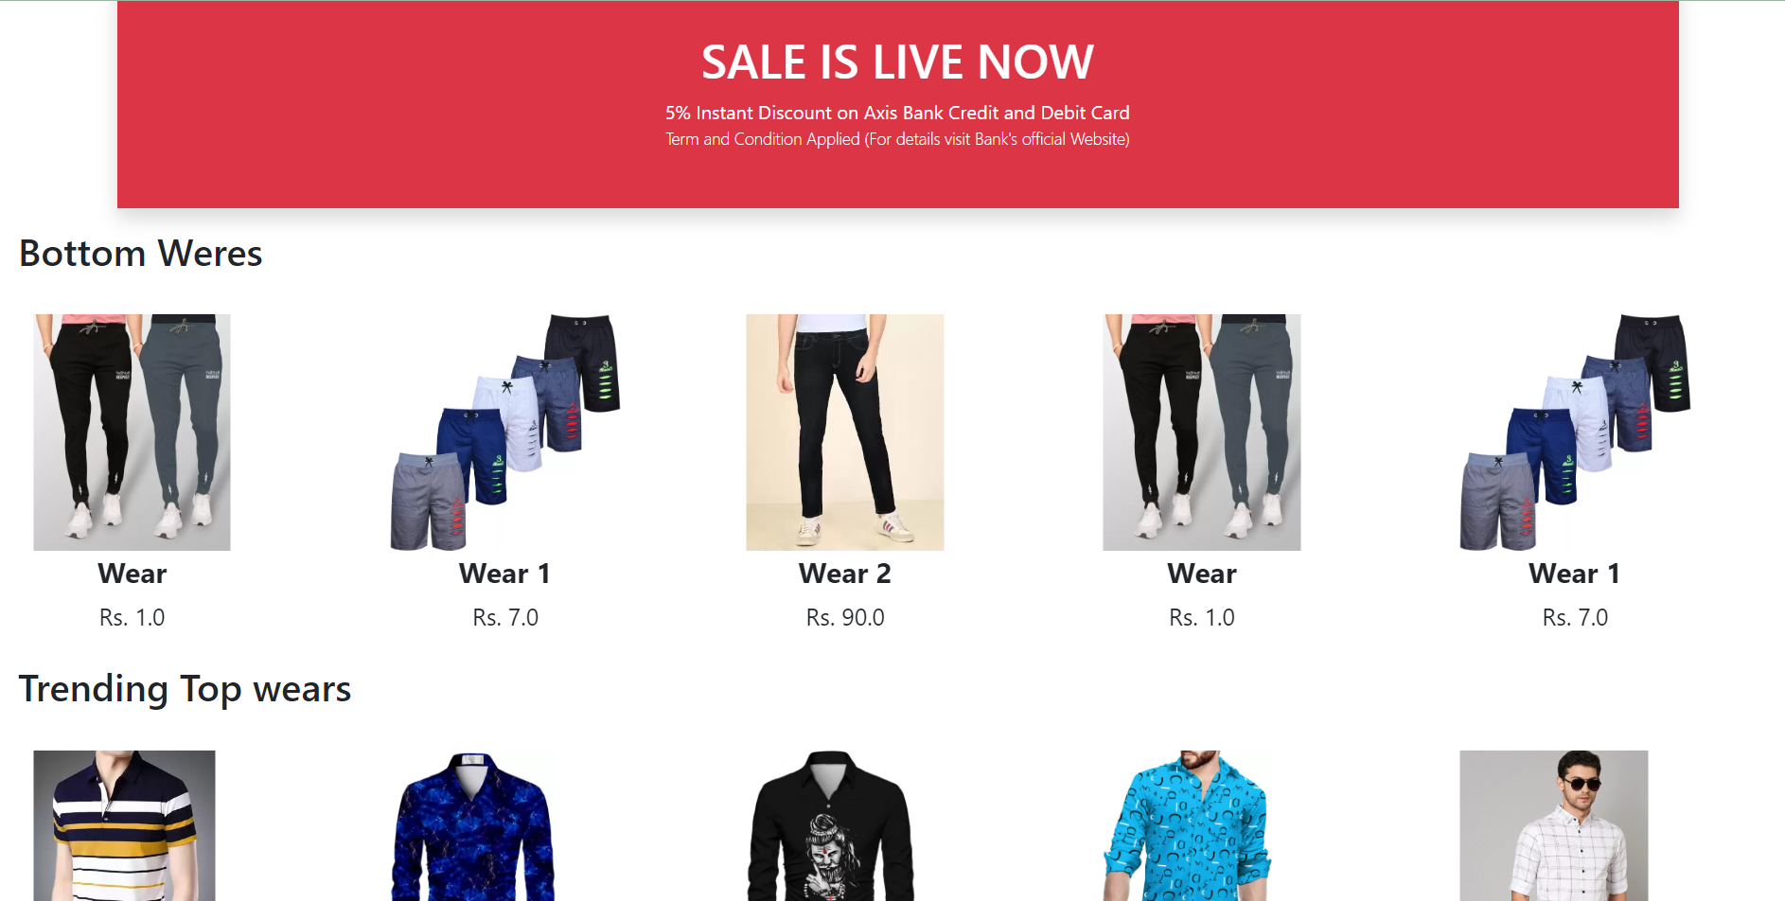
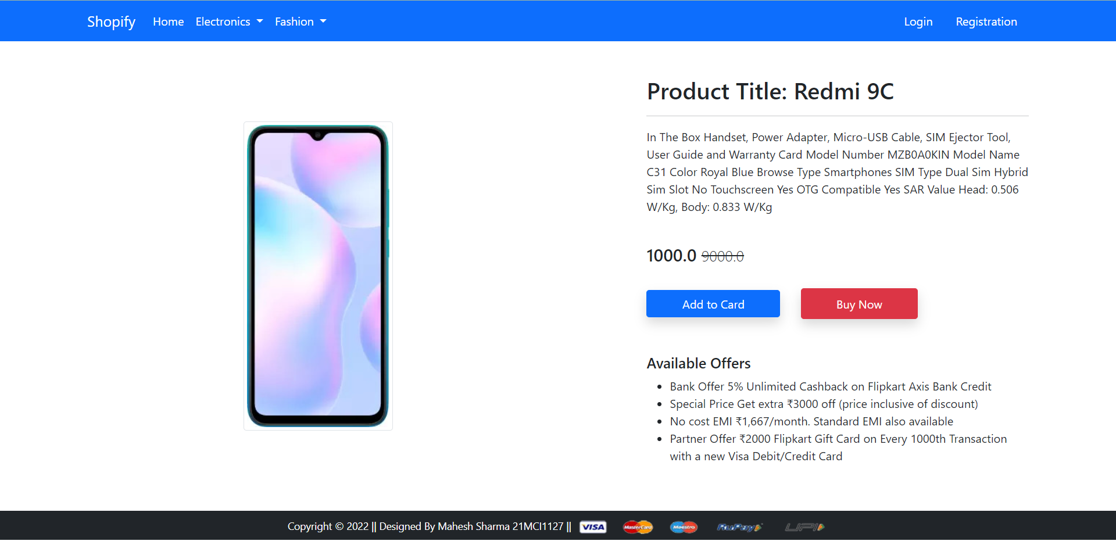
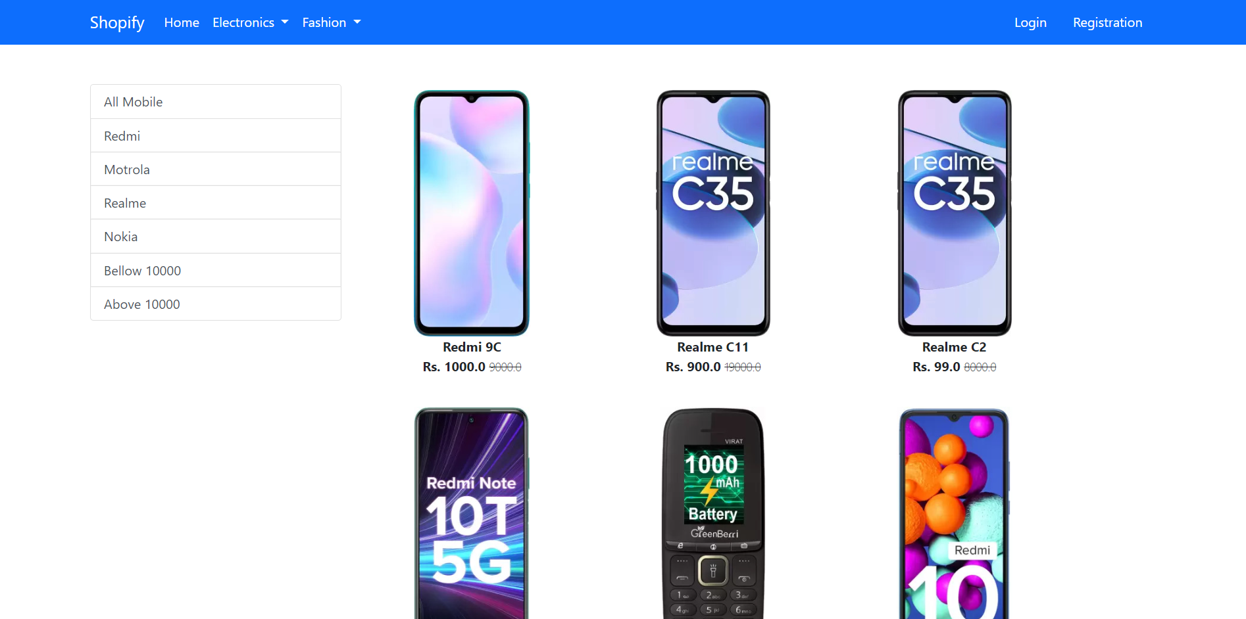
Product Details

Slide 17
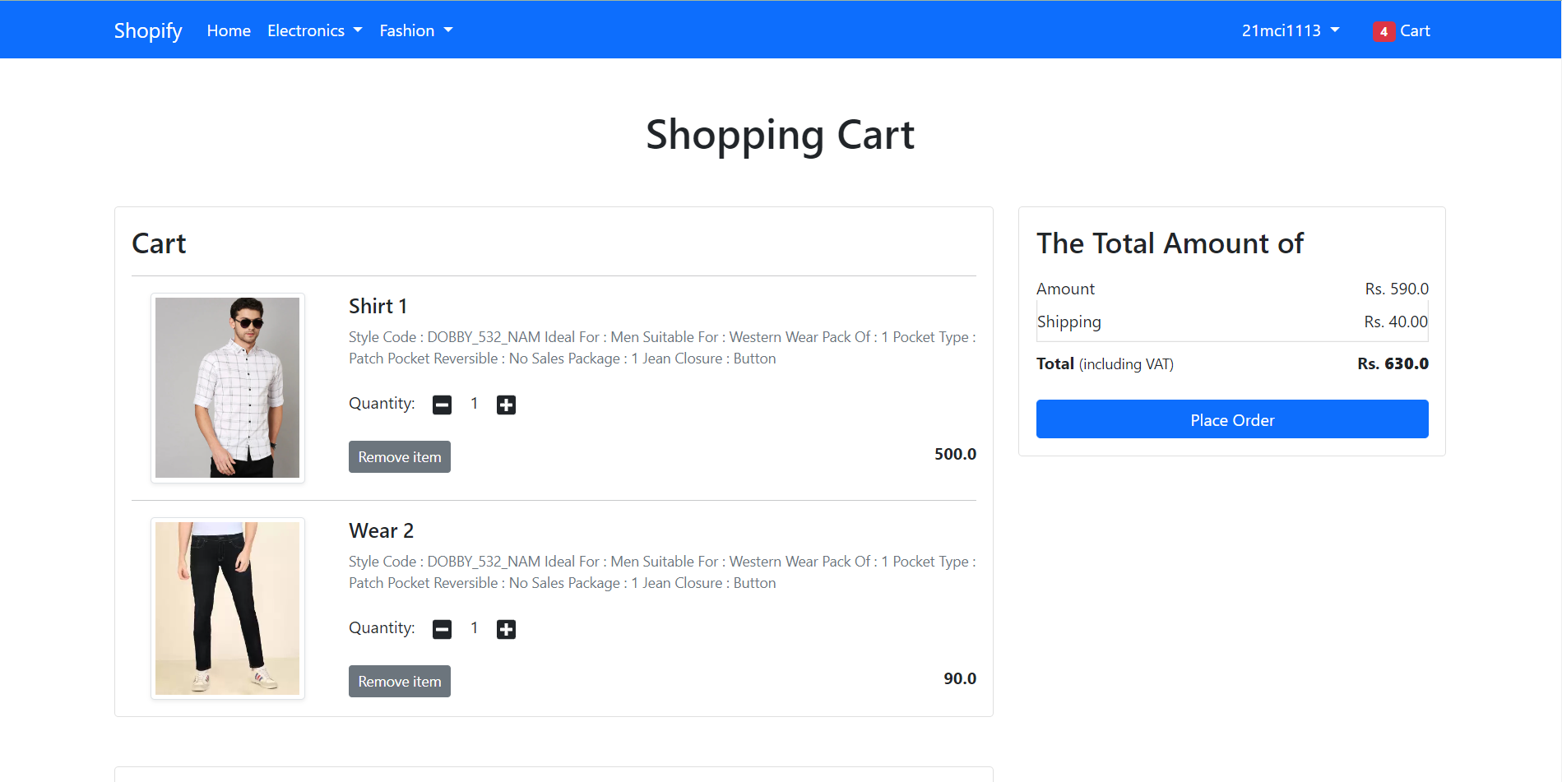
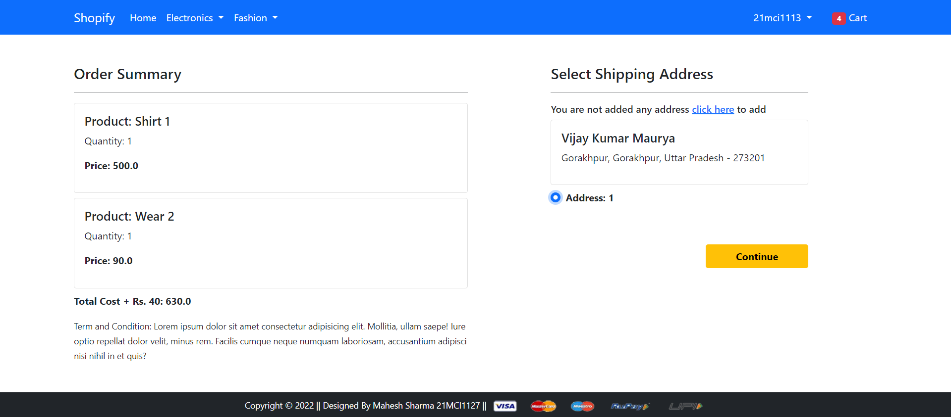
Buy and Click on Place order

Slide 18
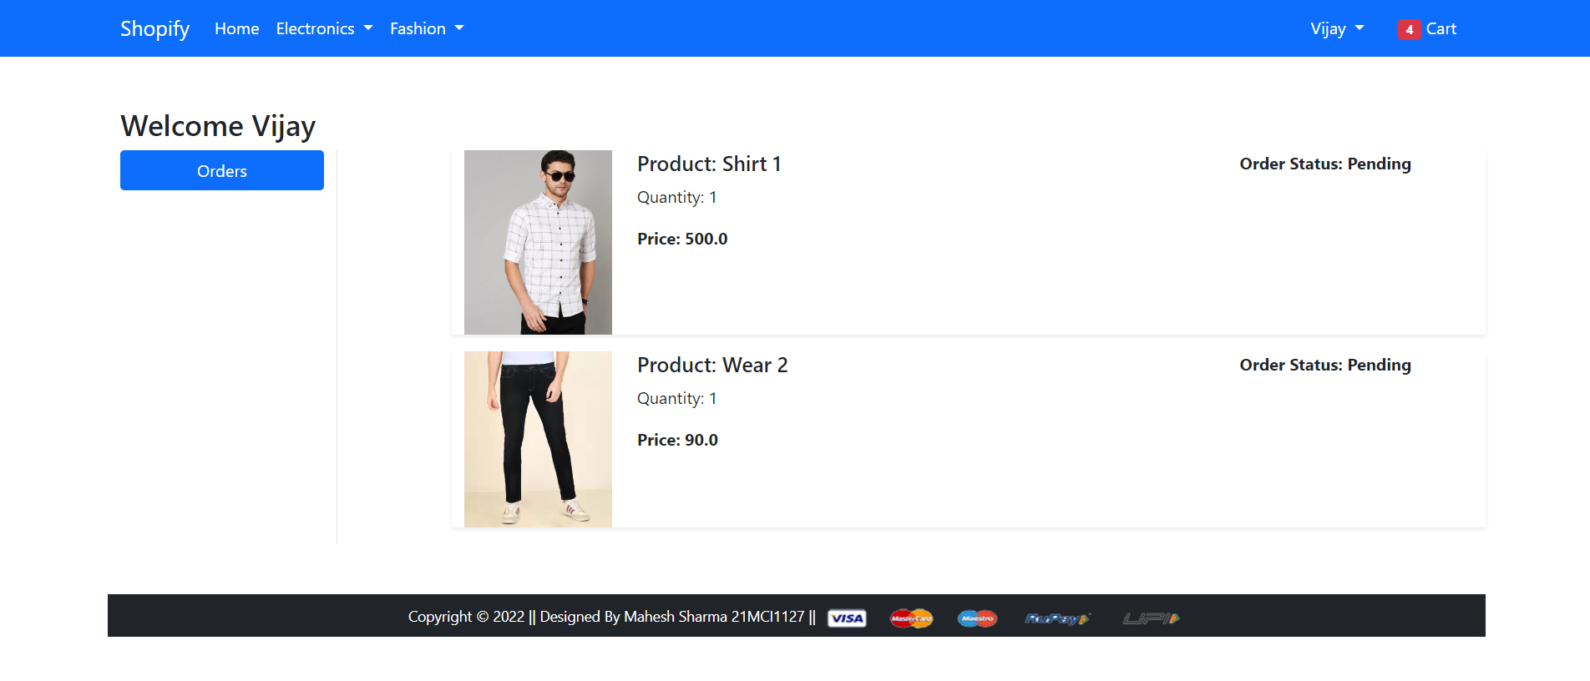
When you click on continue your order will placed

Slide 19
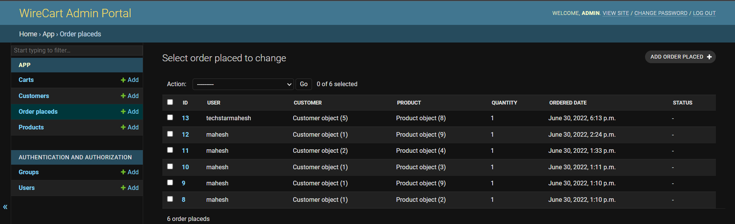
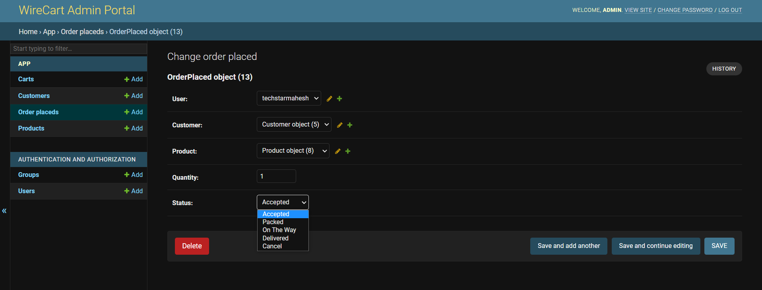
In admin panel you product shown
In this you can change the status

Slide 20
Roadmap to make my project
Product Requirement
Make SQL Relation
Write your code
1
3
5
2
4
6
Design your website
Choose you language to code
And finally go to deploy on github

Slide 21
Future of Project

Slide 22
Conclusion
I use python django framework to make this project.
Front-end i use Bootstrap.
This project is responsive.
In SQL design i use many to one relationship.
There are double scope compared with present.
By this product you can buy and sell your product.
You can Automate your business.

Slide 23
Thank you everyone
Any questions?

